Slide 1

Data-Driven Approach to Predicting Crash Severity Using Machine Learning Techniques
By
Jahnavi Gandu
Pranathi Chirumamilla
Anil Varikuppala
Sadwika Poondla
Sravanthi Kasimsetty
Under
Dr. Coskun Cetinkaya
Asst. Professor, Dept. of Computer Science

Slide 2

The Global Challenge of Road Safety
This study explores the use of machine learning to predict car crash severity, leveraging a rich dataset of crash incidents and exploring the impact of multiple factors.
Car crashes are a major global concern, leading to nearly 1.3 million deaths annually and tens of millions of injuries.
1
Human Cost
2
Economic Burden
Road traffic accidents are a leading cause of global mortality.
Road traffic crashes account for up to 3% of a country's GDP.

Slide 3
The Complexity of Crash Severity Prediction
Crash severity is influenced by a wide array of factors, including driver behavior, environmental conditions, vehicle features, and road infrastructure.
Driver Behavior
Environmental Conditions
Vehicle Features
Speeding, alcohol impairment, and distraction can significantly impact crash severity.
Weather conditions, such as rain or snow, can affect road friction and visibility.
Safety features, such as airbags and anti-lock brakes, can mitigate crash severity.

Slide 4

The Role of Machine Learning
Machine learning provides a promising solution for addressing these challenges.
1
Enhance Predictive Accuracy
By comparing multiple machine learning models, the study identifies the most effective approaches for predicting crash severity.
2
Support Policy and Decision-Making
Data-driven insights enable policymakers and insurance providers to develop targeted interventions.
3
Prevent and Mitigate Crashes
Predicting crash severity in advance can inform the design of preventive measures.

Slide 5
Dataset Description
The dataset contains crash-related data for 51 entries, likely corresponding to U.S. states, with various features capturing factors
influencing car crash severity and associated insurance details.
Column Name
Description
Data Type
total
Total number of car crash incidents reported in the respective region.
float64
speeding
Proportion of crashes attributed to speeding as a contributing factor.
float64
alcohol
Proportion of crashes caused by alcohol impairment.
float64
not_distracted
Proportion of crashes where the driver was not distracted.
float64
no_previous
Proportion of crashes involving drivers with no prior crash records.
float64
ins_premium
Average annual insurance premium (in dollars) for the respective region.
float64
ins_losses
Average insurance losses (in dollars) related to crashes in the respective region.
float64
abbrev
State abbreviation for the corresponding entry.
object

Slide 6
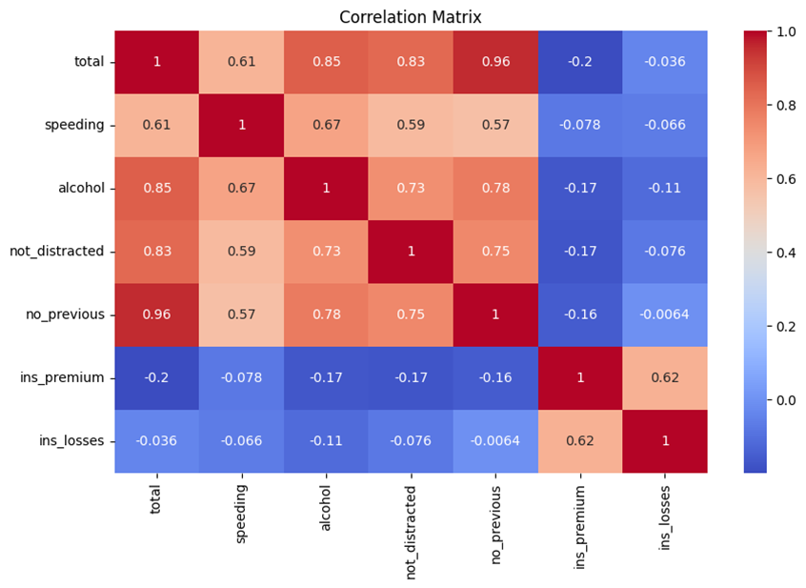
Dataset Analysis

Slide 7
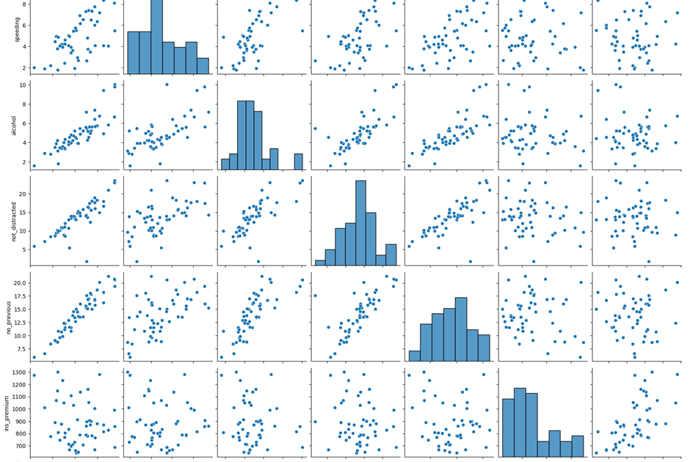
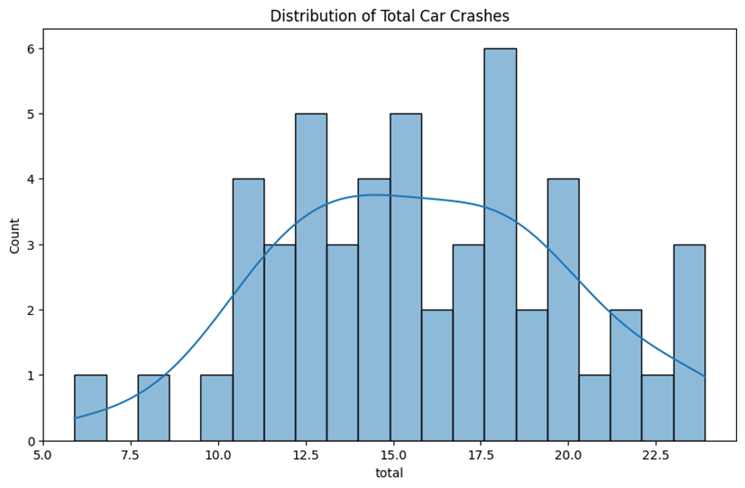
Dataset Analysis

Slide 8
Proposed Algorithms and Applications
This study evaluates and compares four machine learning models for predicting car crash severity.
Linear Regression
Random Forest Regressor
A baseline model to establish fundamental relationships between crash severity and contributing factors.
An ensemble learning technique that builds multiple decision trees and aggregates their outputs for prediction.
Gradient Boosting Regressor
Convolutional Neural Networks (CNN)
An advanced ensemble method that builds trees sequentially to minimize errors from prior trees.
Adapted for tabular data by reshaping inputs into formats suitable for convolutional layers.

Slide 9






Implementation and Experimental Results
Data Loading and Exploration
The dataset was loaded using the seaborn library for initial inspection.
Feature Selection
Features were selected based on exploratory analysis and domain knowledge.
Data Preprocessing
Standardization ensured all features were on the same scale.
Model Implementation
Each algorithm was implemented using Python libraries such as scikit-learn for regression models and TensorFlow/Keras for CNN.
Performance Evaluation
Models were evaluated using Mean Squared Error (MSE) and R-squared (R²) Score.
Visualization
Scatter plots of actual vs. predicted values and comparative bar plots for MSE and R² scores.

Slide 10
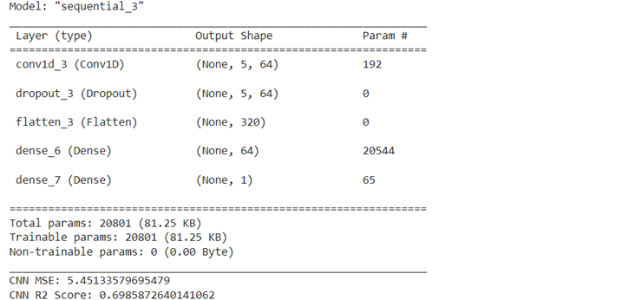
CNN Architecture

Slide 11
Experimental Results
The following results were obtained from the models: Linear Regression, Random Forest Regressor, Gradient Boosting Regressor, and Convolutional Neural Network (CNN).
Model
Mean Squared Error (MSE)
R-squared (R²) Score
Linear Regression
2.1862
0.8791
Random Forest Regressor
2.4369
0.8653
Gradient Boosting Regressor
2.6537
0.8533
Convolutional Neural Network (CNN)
5.4513
0.6986

Slide 12
Advantages and Drawbacks
This study has several advantages, including a comprehensive comparison of algorithms, actionable insights, performance metrics, versatility of models, and scalability.
Advantages
Drawbacks
Comprehensive Comparison of Algorithms
CNN Underperformance
Actionable Insights
Computational Complexity
Performance Metrics
Model Interpretability
Versatility of Models
Data Quality Dependency
Scalability

Slide 13
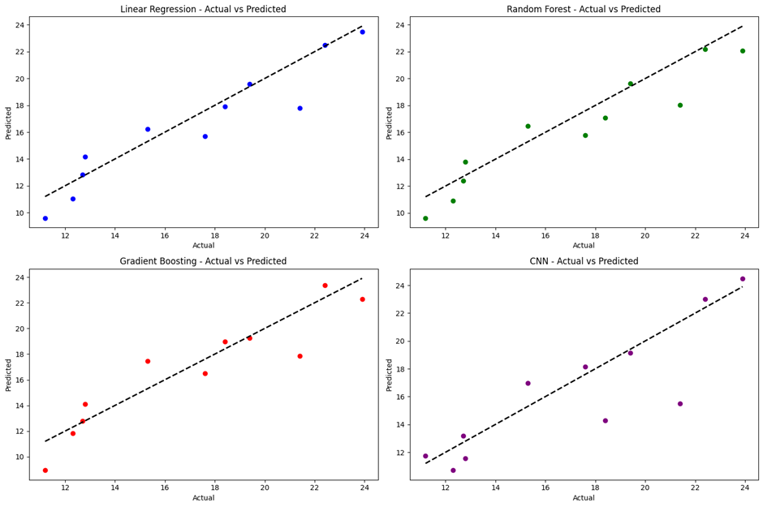
Result

Slide 14
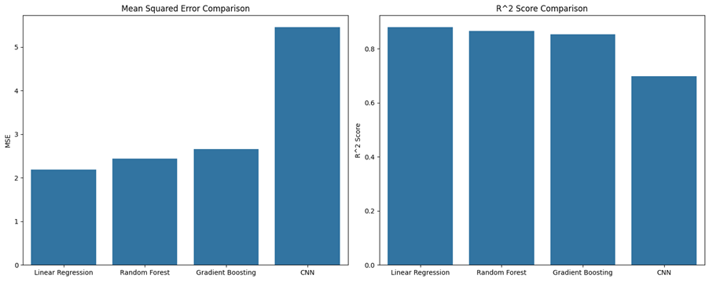
Result

Slide 15




Summary and Conclusion
This study explored machine learning techniques to predict car crash severity, comparing the performance of Linear Regression, Random Forest, Gradient Boosting, and Convolutional Neural Networks.
Road Safety Policy Development
Insurance Risk Assessment
Insights into key predictors, such as weather conditions and road design, allow authorities to implement targeted safety measures.
Predictive models help insurers adjust premiums based on risk profiles, encouraging safer driving behavior.
Emergency Response Optimization
Advanced Analytics for Developing Countries
Severity predictions can guide resource allocation and response planning in high-risk areas.
The study highlights the potential of ML in regions with limited resources, aiding in the global effort to reduce crash-related fatalities.

Slide 16
References
Sattar, K., Chikh Oughali, F., Assi, K., Ratrout, N., Jamal, A., & Masiur Rahman, S. (2023). Transparent deep machine learning framework for predicting traffic crash severity. Neural Computing and Applications, 35(2), 1535-1547.
Ma, Z., Mei, G., & Cuomo, S. (2021). An analytic framework using deep learning for prediction of traffic accident injury severity based on contributing factors. Accident Analysis & Prevention, 160, 106322.
Ahmadi, A., Jahangiri, A., Berardi, V., & Machiani, S. G. (2020). Crash severity analysis of rear-end crashes in California using statistical and machine learning classification methods. Journal of Transportation Safety & Security, 12(4), 522-546.
Ghasedi, M., Sarfjoo, M., & Bargegol, I. (2021). Prediction and analysis of the severity and number of suburban accidents using logit model, factor analysis, and machine learning: A case study in a developing country. SN Applied Sciences, 3(1), 13.
Assi, K., Rahman, S. M., Mansoor, U., & Ratrout, N. (2020). Predicting crash injury severity with machine learning algorithm synergized with clustering technique: A promising protocol. International Journal of Environmental Research and Public Health, 17(15), 5497.
Al-Moqri, T., Haijun, X., Namahoro, J. P., Alfalahi, E. N., & Alwesabi, I. (2020). Exploiting machine learning algorithms for predicting crash injury severity in Yemen: hospital case study. Applied Computational Mathematics, 9(5), 155-164.

Slide 17
Thank You

